Slide 1

Cloud Rangers

Slide 2


Structure (this is for you to start, do not show this slide)
Pain point
Solution
Magic
Demo
Competitiveness & Impact
0.5 minutes
1 minutes
1 minutes
1 minutes
1 minutes
TOTAL: 5 minutes
Please note that this is only a suggestion of how your slide deck could look like. Feel free to change the content, structure, layout, design, or whatever you‘d like to.

Slide 3


Pain point
Surprises in energy bills?
Worried about the world we will leave to the next generations

Slide 4
Our vision
A service
That empower users to make informed decisions
Reducing energy costs
And promoting the use of clean, renewable energy sources

Slide 5
Implementation
User can track its energy consumption.
Provide real-time data of energy pool predictions
Propose more efficient appliances from BSH catalog
Notes
Usets gain valuable insigts into their usage patterns. This is the first step to change the habits.
Real data help users to make informed decisions about their energy consumptions. Users can schedule their appliances usage accordingly. Pub sub notificacions
Proposal of similar appliances in price and functionalities with better efficiency. Comparing consumption, the user can quantify how much money/energy will save.

Slide 6
Solving the problem
Creates awareness of user habits
Easy to use
Cheap
Notes
Awareness of the habits is the first and most important thing to begin change
The application is proposed to be user friendly, keeping the advanced features in the backend, not overengineered. Even not registering consumes, you can estimate with default data.
Cheap
Side effects: will bring new potential customers to our brands and improve BSH marketshare
Big Query will help product development to design better appliances

Slide 7
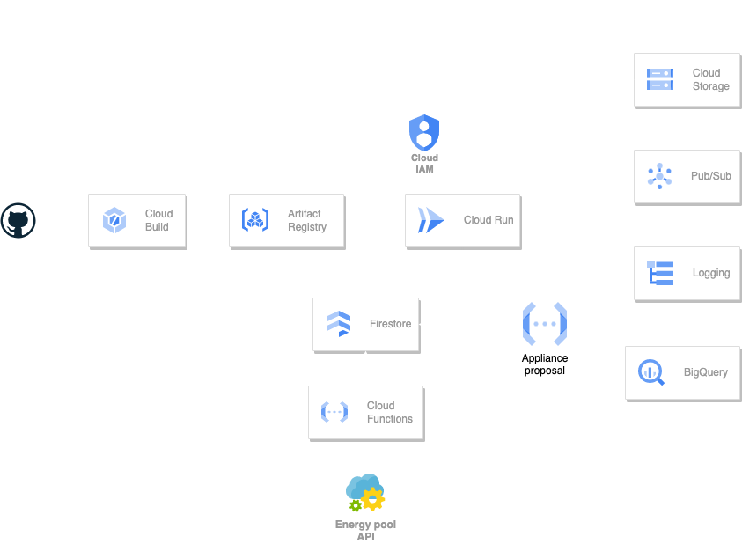

Slide 8
Costs
Per 10.000 users intensive use month
Firestore: $0.06/100.000 documents
Cloud Run: $0.000024 vCPU/s & $0.0000026 GiB/s
Cloud Storage: $0.02/GB
Pub/sub: $0.4/GB
Logging: $0.1/GB
BigQuery: $0.02/GB month
Firestore: 2€
Cloud Run: €100
Cloud Storage: 15€
Pub/sub: <1€
Logging: <1€
BigQuery: 15€
130€/month

Slide 9
Demo
If you have a prototype, include a demo
It is recommended to attach a video instead of doing a live demo. When it is pre-recorded, not much can go wrong
Demonstrate how your solution is solving the pain point
It should explain how it is feasible
The demo should take 1:00 to 1:30 minutes

Slide 10
Competitiveness & Impact
Use evaluation criteria to guide you on what you need to show here
Be aware of competitors
Stay realistic
Why do you believe in your solution? Show your passion
What would happen when the world doesn‘t have your solution?

Slide 11








Nikhil
The CI/CD Comedian
Automation
Priyesh
Security Ninja
Encrypt absolutely everything
Mykola
Generate infinite loops
Avoid disaster
Jorge
Test and break everything
Don‘t break anything

